Slide 1



Exploratory Data Analysis- Deep Data hack 2.0
By team cloudburst:
Abhishek Thakur (2401420020) [leader]
Uday kandpal (2401420015)
Raman singh (2401420021)

Slide 2


Problem statement
Companies face pressure to operate sustainably while maintaining financial performance.
High ESG scores attract investors and demonstrate corporate responsibility.
Challenges: balancing ESG performance with revenue, market cap, and industry demands.

Slide 3

Dataset overview
Dataset spans 2015–2025, covering 11,000 rows of companies across industries and regions.
Key columns: Revenue, ProfitMargin, MarketCap, ESG Overall & Subscores, Carbon/Water/Energy usage.
Each company has 11 rows (one per year).

Slide 4
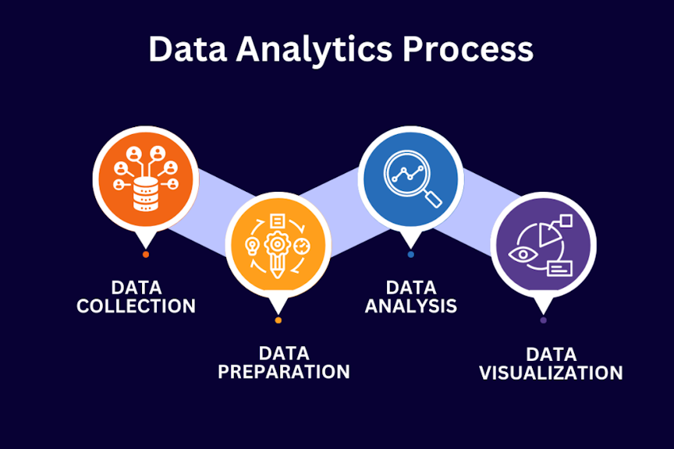

Methodology
Data Understanding: Explore structure, types, missing values, outliers.
Data Preparation: Handle missing values, log-transform financial metrics, create intensity ratios.
Exploratory Data Analysis: Univariate, bivariate, multivariate analysis; visualize distributions, trends, outliers.
Insights & Recommendations: Derive actionable policies for sustainability.

Slide 5
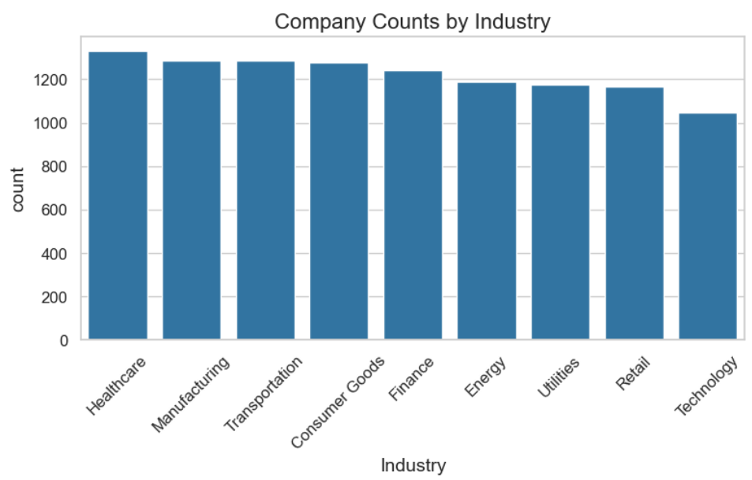
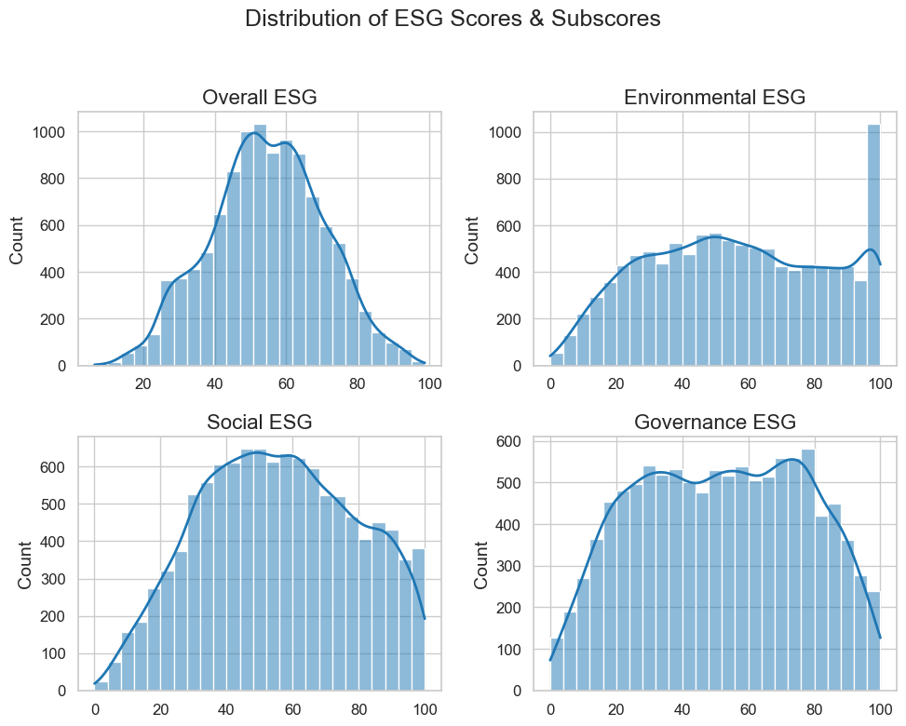
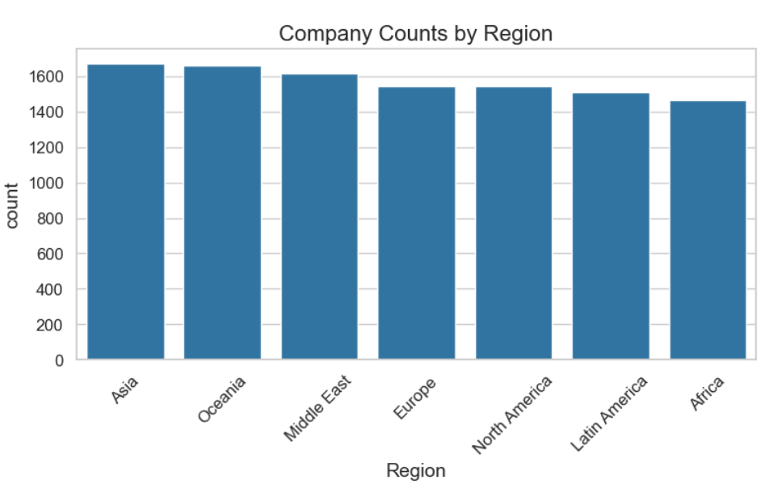
Univariate analysis

Slide 6
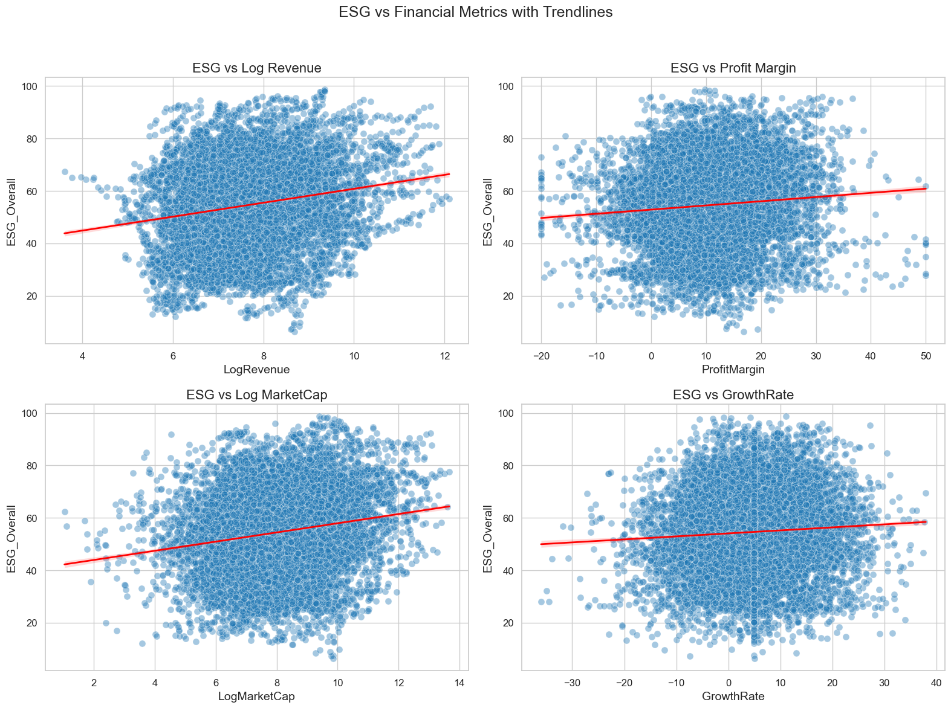

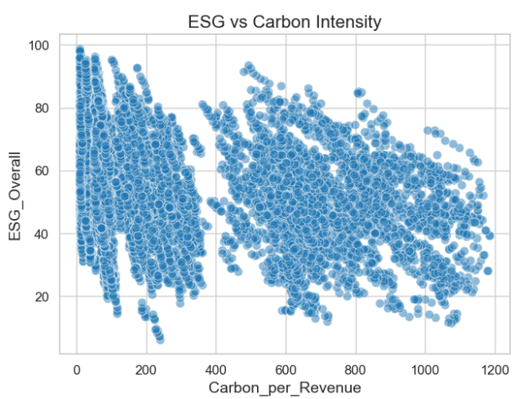
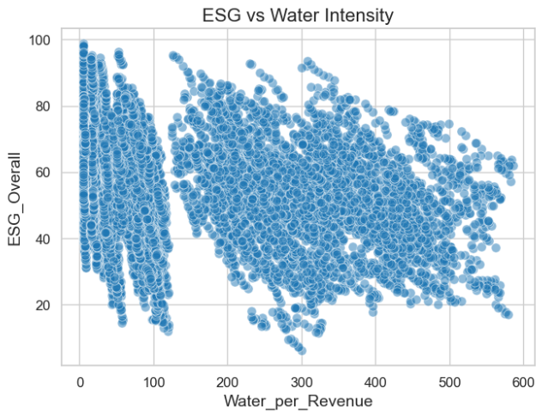
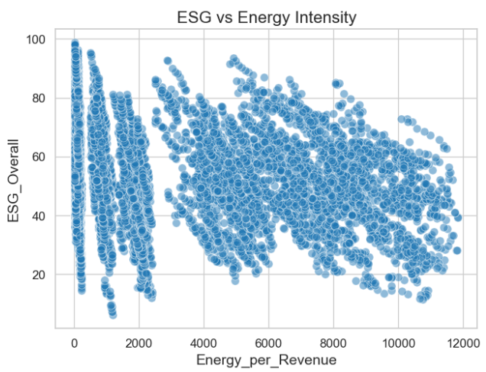
Bivariate analysis

Slide 7
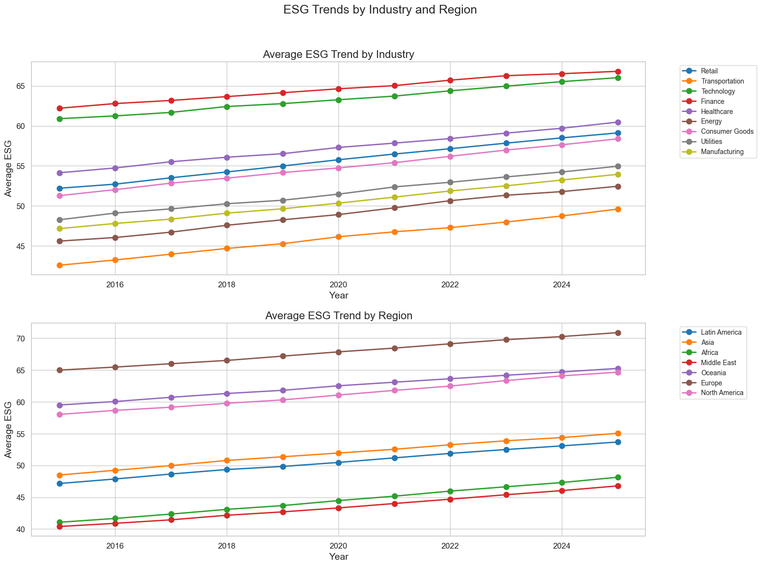
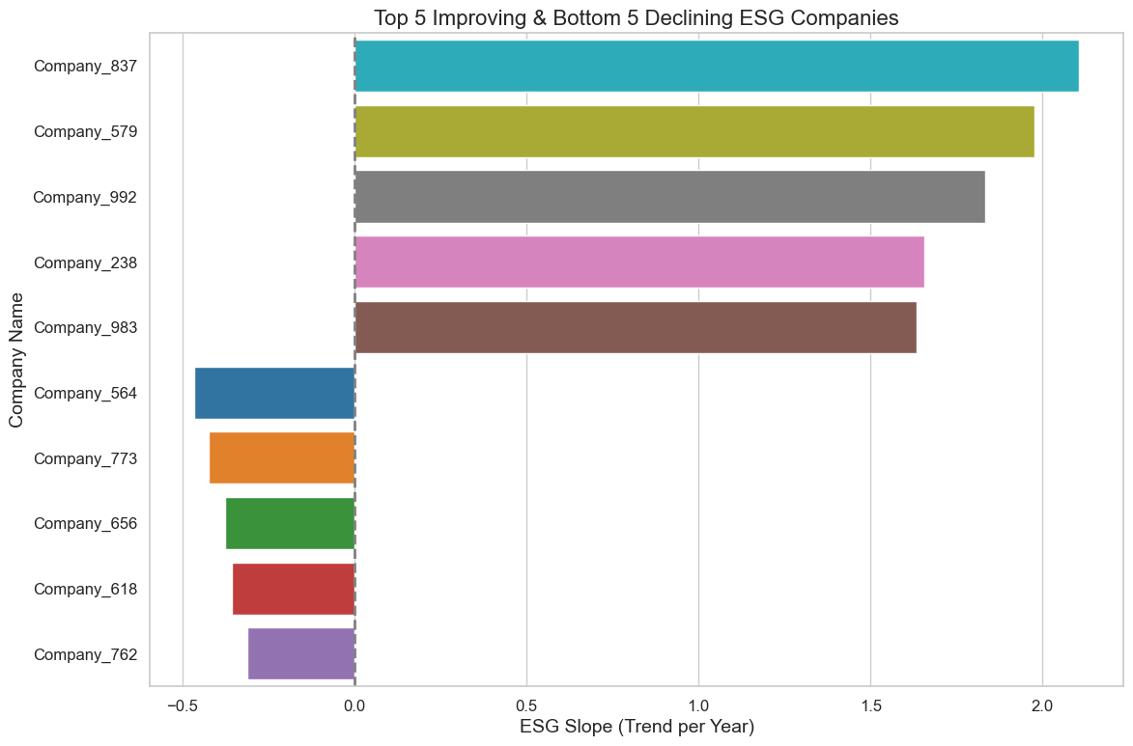
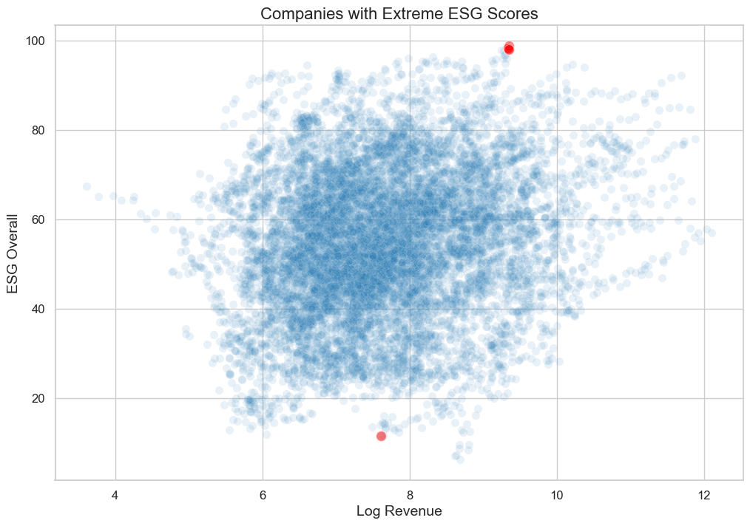
Multivariate analysis

Slide 8

insights
Distribution of ESG scores and subscores mostly predictable; Environmental ESG has spike at top.
Number of companies stable across industry/region.
Resource intensity varies widely; high ESG correlates with lower intensity.
Industry differences significant; Finance & Technology have higher impacts.
Regional patterns exist; Europe highest ESG, Africa & Middle East lowest.
High revenue doesn’t guarantee high ESG.
ESG generally improves over time, though laggards persist.

Slide 9

Policy recommendations
Resource Efficiency Incentives (energy, water, carbon reductions)
Industry-Specific ESG Benchmarks
Regional Best-Practice Programs
Targeted Outlier Engagement
ESG-Integrated Corporate & Investment Decisions

Slide 10

conclusion
ESG scores provide actionable insights beyond financial metrics.
Industry and regional patterns help prioritize sustainability efforts.
Policy recommendations are actionable for companies and investors.
Next Steps: Extend to predictive modeling, ESG risk assessment, or investment scoring.

Slide 11


Thank you!

